Slide 1
Chapter 1
Introduction to e-business and e-commerce

Slide 2
Learning Objectives
Define electronic commerce (EC) and describe its various categories.
Describe and discuss the content and framework of EC.
Describe the major types of EC transactions.
Describe the digital revolution as a driver of EC.
Describe the business environment as a driver of EC.

Slide 3
Learning Objectives
Describe some EC business models.
Describe the benefits of EC to organizations, consumers, and society.
Describe the limitations of EC.
Describe the contribution of EC to organizations responding to environmental pressures.
Describe online social and business networks.

Slide 4
Electronic Commerce: Definitions and Concepts
electronic commerce (EC)
The process of buying, selling, or exchanging products, services, or information via computer networks
e-business
A broader definition of EC that includes not just the buying and selling of goods and services, but also servicing customers, collaborating with business partners, and conducting electronic transactions within an organization

Slide 5
Electronic Commerce: Definitions and Concepts
Pure versus Partial EC
EC can take several forms depending on the degree of digitization
the product (service) sold
the process (e.g., ordering, payment, fulfillment)
the delivery method

Slide 6
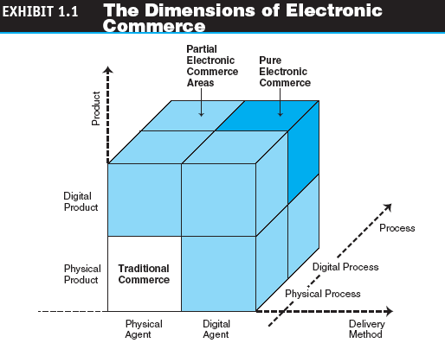
Electronic Commerce: Definitions and Concepts

Slide 7
Electronic Commerce: Definitions and Concepts
brick-and-mortar (old economy) organizations
Old-economy organizations (corporations) that perform their primary business off-line, selling physical products by means of physical agents

Slide 8
Electronic Commerce: Definitions and Concepts
virtual (pure-play) organizations
Organizations that conduct their business activities solely online
click-and-mortar (click-and-brick) organizations
Organizations that conduct some e-commerce activities, usually as an additional marketing channel

Slide 9
Electronic Commerce: Definitions and Concepts
electronic market (e-marketplace)
An online marketplace where buyers and sellers meet to exchange goods, services, money, or information

Slide 10
The EC Framework, Classification, and Content
intranet
An internal corporate or government network that uses Internet tools, such as Web browsers, and Internet protocols
extranet
A network that uses the Internet to link multiple intranets

Slide 11

Types of Parties
Types of parties can be:
Company (B)
Consumer (C )
Government (G)
Person or Peer (P)
Employee (E)

Slide 12

B2B
Business-To-Business. A transaction that occurs between two companies, as opposed to a transaction involving a consumer.
The term may also describe a company that provides goods or services for another company.

Slide 13
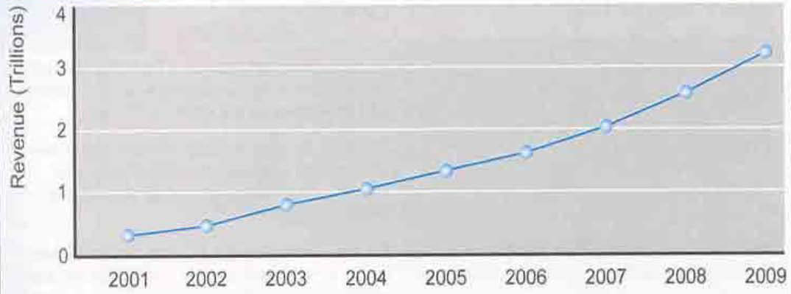
Growth of B2B e-commerce

Slide 14
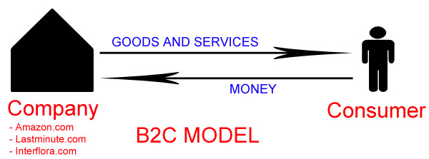
B2C
Business-to-consumer (B2C, sometimes also called Business-to-Customer) describes activities of businesses serving end consumers with products and/or services.

Slide 15
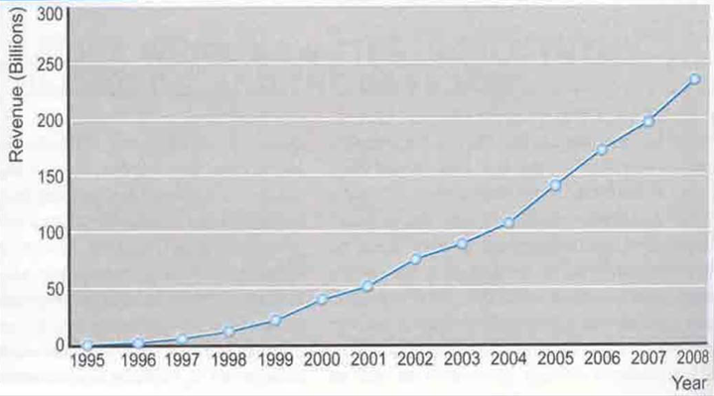
Growth of B2C e-commerce

Slide 16

C2C
Consumer-to-consumer (C2C) (or citizen-to-citizen) electronic commerce involves the electronically-facilitated transactions between consumers.

Slide 17

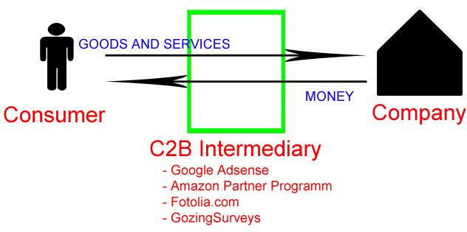
C2B
Consumer-to-business (C2B) is an electronic commerce business model in which consumers (individuals) offer products and services to companies and the companies pay them.

Slide 18
The EC Framework, Classification, and Content
Classification of EC by the Nature of the Transactions or Interactions
business-to-business (B2B)
E-commerce model in which all of the participants are businesses or other organizations

Slide 19
The EC Framework, Classification, and Content
business-to-consumer (B2C)
E-commerce model in which businesses sell to individual shoppers
e-tailing
Online retailing, usually B2C
business-to-business-to-consumer (B2B2C)
describes transactions in which a business sells a service or product to a consumer using another business as an intermediary.

Slide 20
The EC Framework, Classification, and Content
consumer-to-business (C2B)
E-commerce model in which individuals use the Internet to sell products or services to organizations or individuals who seek sellers to bid on products or services they need
mobile commerce (m-commerce)
E-commerce transactions and activities conducted in a wireless environment

Slide 21
The EC Framework, Classification, and Content
location-based commerce (l-commerce)
M-commerce transactions targeted to individuals in specific locations, at specific times
intrabusiness EC
E-commerce category that includes all internal organizational activities that involve the exchange of goods, services, or information among various units and individuals in an organization

Slide 22
The EC Framework, Classification, and Content
business-to-employees (B2E)
E-commerce model in which an organization delivers services, information, or products to its individual employees
collaborative commerce (c-commerce)
E-commerce model in which individuals or groups communicate or collaborate online
consumer-to-consumer (C2C)
E-commerce model in which consumers sell directly to other consumers

Slide 23
The EC Framework, Classification, and Content
peer-to-peer (P2P)
Technology that enables networked peer computers to share data and processing with each other directly; can be used in C2C, B2B, and B2C e-commerce
e-learning
The online delivery of information for purposes of training or education
e-government
E-commerce model in which a government entity buys or provides goods, services, or information from or to businesses or individual citizens

Slide 24
B2B (Business-to-Business) Companies doing business with each other such as manufacturers selling to distributors and wholesalers selling to retailers. Pricing is based on quantity of order and is often negotiable. Examples:
Intel selling microprocessor to Dell
Heinz selling ketchup to Mc Donalds

Slide 25
B2C (Business-to-Consumer) Businesses selling to the general public typically through catalogs utilizing shopping cart software.
Example:
Dell selling me a laptop

Slide 26
C2B (Consumer-to-Business) A consumer posts his project with a set budget online and within hours companies review the consumer's requirements and bid on the project. The consumer reviews the bids and selects the company that will complete the project.

Slide 27
C2C (Consumer-to-Consumer) There are many sites offering free classifieds, auctions, and forums where individuals can buy and sell thanks to online payment systems like PayPal where people can send and receive money online with ease. eBay's auction service is a great example of where person-to-person transactions take place everyday since 1995.

Slide 28
The Benefits of Electronic Business
Benefits to Organizations
Expands the marketplace to national and international markets
Decreases the cost of creating, processing, distributing, storing and retrieving paper-based information
Allows reduced inventories and overhead by facilitating “pull” type supply chain management
The pull type processing allows for customization of products and services which provides competitive advantage to its implementers

Slide 29
Benefits to Customers
Enables customers to shop or do other transactions 24 hours a day, all year round from almost any location
Provides customers with more choices
Provides customers with less expensive products and services by allowing them to shop in many places and conduct quick comparisons
Allows quick delivery of products and services in some cases, especially with digitized products

Slide 30
Benefits to Customers (cont.)
Customers can receive relevant and detailed information in seconds, rather than in days or weeks
Makes it possible to participate in virtual auctions
Allows customers to interact with other customers in electronic communities and exchange ideas as well as compare experiences
Electronic commerce facilitates competition, which results in substantial discounts.

Slide 31
Benefits to Society
Enables more individuals to work at home, and to do less traveling for shopping, resulting in less traffic on the roads, and lower air pollution
Allows some merchandise to be sold at lower prices benefiting the poor ones
Enables people in Third World countries and rural areas to enjoy products and services which otherwise are not available to them
Facilitates delivery of public services at a reduced cost,increases effectiveness, and/or improves quality

Slide 32
The Limitations of E- Business
Technical Limitations of EB.
Lack of sufficient system’s security, reliability, standards, and communication protocols
The software development tools are still evolving and changing rapidly
Difficulties in integrating the Internet and electronic commerce software with some existing applications and databases

Slide 33
Non-Technical Limitations
Cost and justification (35% of the respondents)
The cost of developing an EC in house can be very high, and mistakes due to lack of experience, may result in delays.

Slide 34
Non-Technical Limitations (cont.)
Security and Privacy (17% of the respondents)
These issues are especially important in the B2C area, and security concerns are not truly so serious from a technical standpoint. Privacy measures are constantly improving too. Yet, the customers perceive these issues as very important and therefore the EC industry has a very long and difficult task of convincing customers that online transactions and privacy are, in fact, fairly secure.

Slide 35
Non-Technical Limitations (cont.)
Lack of trust and user resistance (4%)
Customers do not trust an unknown faceless seller, paperless transactions, and electronic money. So switching from a physical to a virtual store may be difficult.

Slide 36
Non-Technical Limitations (cont.)
Other limiting factors are:
Lack of touch and feel online
Many unresolved legal issues
Rapidly evolving and changing EC
Lack of support services
Insufficiently large enough number of sellers and buyers
Breakdown of human relationships
Expensive and/or inconvenient accessibility to the Internet

Slide 37
Digital Revolution Drives EB
digital economy
An economy that is based on digital technologies, including digital communication networks, computers, software, and other related information technologies; also called the Internet economy, the new economy, or the Web economy

Slide 38
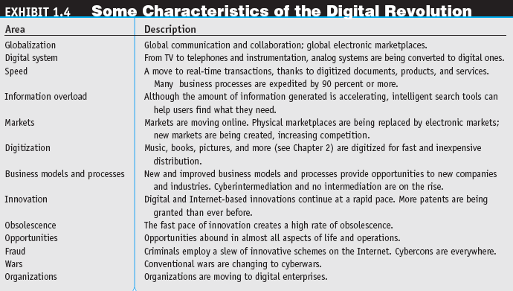
Digital Revolution Drives EB

Slide 39
Business Environment Drives EB
Impact of the Digital Revolution
Customers are becoming more powerful
Companies need to react more quickly

Slide 40
Business Environment Drives EB
Changing Business Environment
Business environment is more turbulent
More business problems and opportunities
Stronger competition
Need for the organization to make decisions more frequently
Decisions are larger in scope because more factors need to be evaluated (market, competition, political issues, global environment)
More information is needed to make decisions

Slide 41
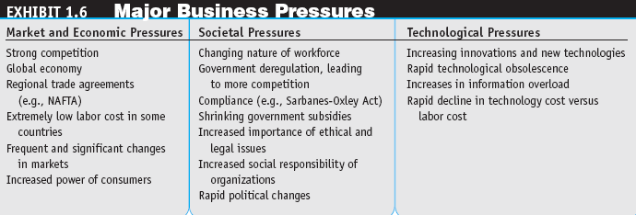
Business Environment Drives EB

Slide 42
EB Business Models
Electronic Business enables the creation of new business models
business model = a method of doing business by which a company can generate revenue to sustain itself

Slide 43
EB Business Models
Six elements of a business model include descriptions of:
Customers to be served and the company’s relationships with these customers including customers’ value proposition
All products and services the business will offer
The business process required to make and deliver the products and services
The resources required and the identification of which ones are available, which will be developed in house, and which will need to be acquired
The organization’s supply chain, including suppliers and other business partners
The revenues expected (revenue model), anticipated costs, sources of financing, and estimated profitability (financial viability)

Slide 44
What Is the Supply Chain?
Also referred to as the logistics network
Suppliers, manufacturers, warehouses, distribution centers and retail outlets – “facilities”
and the
Raw materials
Work-in-process (WIP) inventory
Finished products
that flow between the facilities
Suppliers
Manufacturers
Warehouses &
Distribution Centers
Customers
Transportation
Costs
Transportation
Costs
Transportation
Costs
Material Costs
Manufacturing Costs
Inventory Costs

Slide 45
The Supply Chain
Suppliers
Manufacturers
Warehouses &
Distribution Centers
Customers
Transportation
Costs
Transportation
Costs
Material Costs
Transportation
Costs
Manufacturing Costs
Inventory Costs

Slide 46
The Supply Chain – Another View
Plan
Source
Make
Deliver
Buy
Suppliers
Manufacturers
Warehouses &
Distribution Centers
Customers
Transportation
Costs
Transportation
Costs
Material Costs
Manufacturing Costs
Transportation
Costs
Inventory Costs

Slide 47
What Is Supply Chain Management (SCM)?
Plan
Source
Make
Deliver
Buy
A set of approaches used to efficiently integrate
Suppliers
Manufacturers
Warehouses
Distribution centers
So that the product is produced and distributed
In the right quantities
To the right locations
And at the right time
System-wide costs are minimized and
Service level requirements are satisfied

Slide 48
EB Business Models
revenue model
Description of how the company or an EC project will earn revenue
value proposition
The benefits a company can derive from using EC

Slide 49
Social and Business Networks
social networks
Web sites that connect people with specified interests by providing free services such as photo presentation, e-mail, blogging, etc.
Business-oriented networks are social networks whose primary objective is to facilitate business

Slide 50
The Digital Enterprise
digital enterprise
A new business model that uses IT in a fundamental way to accomplish one or more of three basic objectives: reach and engage customers more effectively, boost employee productivity, and improve operating efficiency. It uses communication and computing technology in a way that improves business processes

Slide 51
The Digital Enterprise
corporate portal
A major gateway through which employees, business partners, and the public can enter a corporate Web site

Slide 52
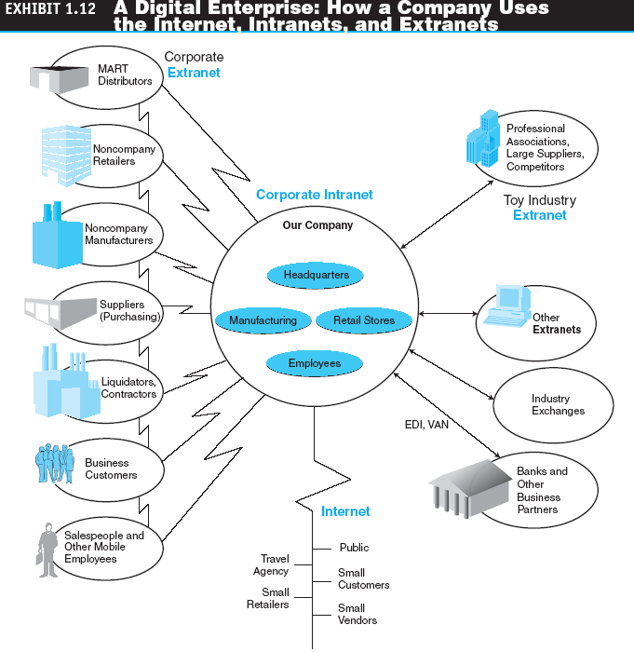
The Digital Enterprise

Slide 53
Managerial Issues
Why is B2B so attractive?
There are so many EB failures—how can one avoid them?
How do we transform our organization into a digital one?

